Slide 1

LET US C
BY YASHAVANT KANETKAR
CH 7 Q[B]
CH 7 Q[D]
CH 7 Q[A]
CH 7 Q[C]
CHAPTER 7 SOLUTIONS
CASE CONTROL INSTRUCTION

Slide 2
CHAPTER 7 SOLUTIONS
CASE CONTROL INSTRUCTION
Q[A] What will be the output of the following programs:
CH 7 Q[A]
(a)
#include <stdio.h>
int main()
{
char suite = 3;
switch (suite)
{
case 1:
printf("Diamond\n");
case 2:
printf("Spade\n");
default:
printf("Heart\n");
}
printf("I thought one wears a suite\n");
return 0;
}
(b)
(c)
CH 7 Q[C]
CH 7 Q[B]
(d)
(e)
DEAR CODING
(f)
BOOK: LET US C
BY YASHAVANT KANETKAR

Slide 3

CHAPTER 7 SOLUTIONS
CASE CONTROL INSTRUCTION
(a)
#include <stdio.h>
int main()
{
char suite = 3;
switch (suite)
{
case 1:
printf("Diamond\n");
case 2:
printf("Spade\n");
default:
printf("Heart\n");
}
printf("I thought one wears a suite\n");
return 0;
}
👩‍💻 Output:
CH 7 Q[A](a)
✍️ No case matches to 3, so default case will be executed. The program will print "Heart” and the last printf statement.
DEAR CODING
BOOK: LET US C
BY YASHAVANT KANETKAR

Slide 4
CHAPTER 7 SOLUTIONS
CASE CONTROL INSTRUCTION
(b)
#include <stdio.h>
int main()
{
int c = 3;
switch (c)
{
case '3':
printf("You never win the silver prize\n");
break;
case 3:
printf("You always lose the gold prize\n");
break;
default:
printf("Of course provided you win a prize\n");
}
return 0;
}
👩‍💻 Output:
CH 7 Q[A](b)
DEAR CODING
BOOK: LET US C
BY YASHAVANT KANETKAR

Slide 5

CHAPTER 7 SOLUTIONS
CASE CONTROL INSTRUCTION
(c)
#include <stdio.h>
int main()
{
int i = 3;
switch (i) {
case 0:
printf("Customers are dicey\n");
case 1 + 0:
printf("Markets are pricey\n");
case 4 / 2:
printf("Investors are moody\n");
case 8 % 5:
printf("At least employees are good\n");
}
return 0;
}
👩‍💻 Output:
CH 7 Q[A](c)
DEAR CODING
BOOK: LET US C
BY YASHAVANT KANETKAR

Slide 6

CHAPTER 7 SOLUTIONS
CASE CONTROL INSTRUCTION
(d)
#include <stdio.h>
int main()
{
int k;
float j = 2.0;
switch (k=j+1) {
case 3:
printf("Trapped\n");
break;
default:
printf("Caught!\n");
}
return 0;
}
👩‍💻 Output:
CH 7 Q[A](d)
✍️ switch cannot be used with float, double.
✍️ k is integer, so the value of j + 1, which is 3.0 will be truncated to 3, and hence case 3 will match.
DEAR CODING
BOOK: LET US C
BY YASHAVANT KANETKAR

Slide 7


CHAPTER 7 SOLUTIONS
CASE CONTROL INSTRUCTION
(e)
#include <stdio.h>
int main()
{
int ch = 'a' + 'b';
switch (ch) {
printf("You entered b\n");
case 'a' :
case 'b':
case 'A':
printf("a as in ashar\n");
case 'b' + 'a' :
printf("You entered a and b\n");
}
return 0;
}
👩‍💻 Output:
CH 7 Q[A](e)
✍️ NO ERROR
DEAR CODING
BOOK: LET US C
BY YASHAVANT KANETKAR

Slide 8
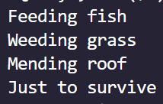
CHAPTER 7 SOLUTIONS
CASE CONTROL INSTRUCTION
(f)
#include <stdio.h>
int main()
{
int i = 1;
switch (i-2) {
case -1:
printf("Feeding fish\n");
case 0:
printf("Weeding grass\n");
case 1:
printf("Mending roof\n");
default:
printf("Just to survive\n");
}
return 0;
}
👩‍💻 Output:
CH 7 Q[A](f)
✍️ There is no break statement after each case, the program will execute other cases as well even after the match with the first case -1.
DEAR CODING
BOOK: LET US C
BY YASHAVANT KANETKAR

Slide 9
CHAPTER 7 SOLUTIONS
CASE CONTROL INSTRUCTION
(a)
#include <stdio.h>
int main()
{
int suite = 1;
switch (suite);
{
case 0;
printf("Club\n");
case 1;
printf("Diamond\n");
}
return 0;
}
CH 7 Q[B](a)
✍️ case label 0 and case label 1 are not within a switch statement because of ; after switch statement. Expected : instead of ; after switch, and in case statements.
DEAR CODING
BOOK: LET US C
BY YASHAVANT KANETKAR

Slide 10
CHAPTER 7 SOLUTIONS
CASE CONTROL INSTRUCTION
(b)
#include <stdio.h>
int main()
{
int temp;
scanf("%d", &temp);
switch (temp)
{
case (temp <= 20):
printf("Ooooooohhhh! Damn cool!\n");
case (temp > 20 && temp <= 30):
printf("Rain rain here again!\n");
case (temp > 30 && temp <= 40):
printf("Wish I am on Everest\n");
default:
printf("Good old nagpur weather\n");
}
return 0;
}
CH 7 Q[B](b)
❌
ERROR!
✍️ Relational operators cannot be used in switch cases in switch cases. switch cases can only have an expression reducing to an integer.
DEAR CODING
BOOK: LET US C
BY YASHAVANT KANETKAR

Slide 11


CHAPTER 7 SOLUTIONS
CASE CONTROL INSTRUCTION
(c)
#include <stdio.h>
int main()
{
float a = 3.5;
switch (a)
{
case 0.5:
printf("The art of C\n");
break;
case 1.5:
case 2.5:
printf("The spirit of C\n");
break;
printf("See through C\n"); break;
}
return 0;
}
CH 7 Q[B](c)
DEAR CODING
✍️ switch cases cannot have float, double.
BOOK: LET US C
BY YASHAVANT KANETKAR

Slide 12

CHAPTER 7 SOLUTIONS
CASE CONTROL INSTRUCTION
(d)
#include <stdio.h>
int main()
{
int a = 3, b = 4, c;
c = b - a;
switch (c)
{
case 1 || 2:
printf("God give me a chance to change things\n");
break;
case a || b:
printf("God give me a chance to run my show\n");
break;
}
return 0;
}
CH 7 Q[B](d)
✍️ Logical operators cannot be used in cases.
DEAR CODING
BOOK: LET US C
BY YASHAVANT KANETKAR

Slide 13
CHAPTER 7 SOLUTIONS
CASE CONTROL INSTRUCTION
Q[C] Write a menu driven program which has following options:
1. Factorial of a number
2. Prime or not
3. Odd or even
4. Exit
Once a menu item is selected the appropriate action should be taken and once this action is finished, the menu should reappear. Unless the user selects the 'Exit' option the program should continue to run.
Hint: Make use of an infinite while and a switch statement.
CH 7 Q[C]
DEAR CODING
BOOK: LET US C
BY YASHAVANT KANETKAR

Slide 14
CHAPTER 7 SOLUTIONS
CASE CONTROL INSTRUCTION
Q[D] Write a program to find the grace marks for a student using switch. The user should enter the class obtained by the student and the number of subjects he has failed in. Use the following logic:
- If the student gets first class and the number of subjects, he failed in is greater than 3, then he does not get any grace. Otherwise, the grace is of 5 marks per subject.
- If the student gets second class and the number of subjects, he failed in is greater than 2, then he does not get any grace. Otherwise, the grace is of 4 marks per subject.
- If the student gets third class and the number of subjects, he failed in is greater than 1, then he does not get any grace. Otherwise, the grace is of 5 marks.
CH 7 Q[D]
DEAR CODING
BOOK: LET US C
BY YASHAVANT KANETKAR

Slide 15
LET US C
BY YASHAVANT KANETKAR
CH 8 Q[D]
CH 8 Q[B]
CH 8 Q[C]
CH 8 Q[A]
CHAPTER 8 SOLUTIONS
FUNCTIONS

Slide 16


🔴Let me create amazing coding tutorials for you forever!🙂
👇👇👇👇👇👇👇👇👇👇👇👇👇👇👇👇👇👇
👉 SUBSCRIBE 🤛
CH 8 Q[D]
CH 8 Q[B]
CHAPTER 8 SOLUTIONS
FUNCTIONS
CH 8 Q[C]
CH 8 Q[A]
Thanks for your valuable time!

Slide 17
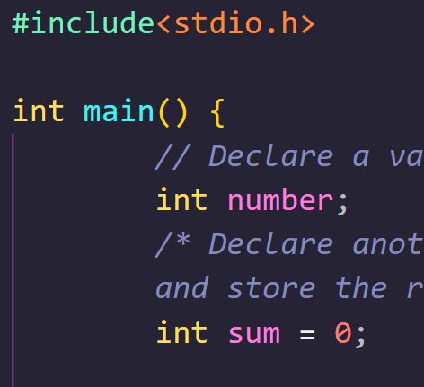
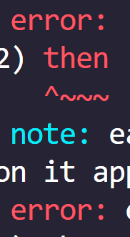

DEAR CODING

